Slide 1
Crystal Geometry and Structure Determination (Atomic Packing Factor)
Dr. Ranjit Kumar
Department of Chemical Engineering
Email: ranjit.kumar@snu.edu.in

Slide 2
ATOMIC RADIUS
Half the distance between the nearest neighbouring atoms
in a crystal is called atomic radius.
A
B
AB = X
Therefore, r = X/2
Since, r – atomic radius

Slide 3
Nearest neighbour distance(2r)
The distance between the centers of two nearest
neighbouring atoms is called nearest neighbour distance.
It will be 2r if r is the radius of the atom.

Slide 4
Co-ordination number
The number of equidistant nearest neighbours that an atom
has in the given structure is known as co-ordination number.
NOTE:
By the help of co-ordination number we may say that given structure is either closely packed (or) loosely packed structure.

Slide 5
Atomic packing fraction
The ratio between the volume occupied by the atoms
in the unit cell (v) to the total volume of the same
unit cell (V) is called the atomic packing factor.
i.e.
APF = v/V
NOTE:
From APF value also we must say that the given
Structure is either closed (OR) loosely packed structure.

Slide 6
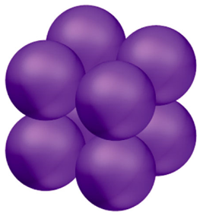
SIMPLE CUBIC STRUCTURE(SC)
All atoms are kept at corners of the unit cell only,
consequently these atoms touch along cube edges.
a

Slide 7
2. Co-ordination number
Each atom has only 6 nearest neighbours .
Hence, co-ordination number is six.
+Y
-Z
-X
A
+X
a
+Z
-Y
Because each corner atom has four neighbours in the same plane one vertical
above and one immediately below.

Slide 8


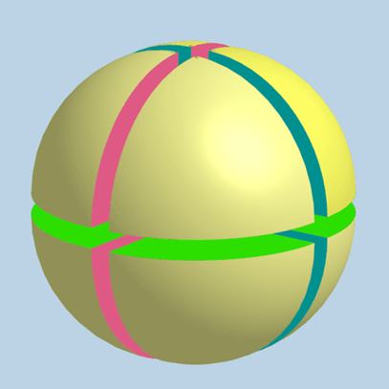
How many atoms…….
Each corner atom is shared by 8 surrounding unit cells,
share of each corner of unit cell comes to one-eight
of an atom. Hence, each unit cell contains eight corner
atoms. So the unit cell of simple cube contains only 1 atom.
i.e. 8 x 1/8 = 1 atom

Slide 9
4. Therefore, the total number of atoms in a unit cell is one.
So in this case, the unit cell is equal
to the primitive cell.
It is a 1-layer structure. Hence, it’s stacking
sequence is A A A A A …….

Slide 10
6. Atomic packing factor
APF = v / V
1x 4/3 π R³
=
a³
1x 4/3 π R³
=
since, a =2R
(2R)³
Therefore, APF
= π / 6 = 0.523 OR 52%
It’s APF value is only 52%.hence, it is a loosely packed structure.
Ex: Only polonium (Po) exhibits in a certain temperature region.

Slide 11
BODY CENTERED CUBIC STRUCTURE(BCC)
Atoms are kept at corners of the unit cell including one
atom exactly centre of the unit cell.
Consequently these atoms touch along the body diagonals,
hence the nearest concept is along the body diagonals.

Slide 12
2. Co-ordination number
The nearest neighbouring atoms of any case are the
body centered atoms, not the other corner atoms.
Hence ,each atom has only 8 nearest neighbours.
Hence, its co-ordination number is 8.

Slide 13
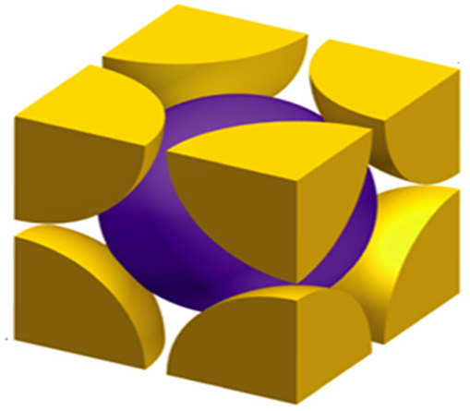
Each corner has one atom, but shares only one-eight part of an atom like
simple cubic structure & one more atom exactly occupies center of the body.
Hence, it is known as Body centered cubic structure.

Slide 14
4. Total number of atoms in a unit cell of BCC is 2.
i.e.
8 x 1 /8 + 1 = 1 + 1 = 2 atoms
It is a 2-layer structure. Hence, it’s stacking sequence
is AB AB AB AB AB AB …………….

Slide 15
6. Atomic packing factor
a
D
D
r
2r
A
r
A
C
B
Figure 1
Figure 2

Slide 16
From figure 1,
∆ ABC AC² = AB² + BC² = a² + a² = 2a² --------- (1)
∆ ACD AD² = AC² + CD² = 2a² + a² = 3a²
AD² = 3a² (OR)
AD = √3 a ------------- (2)
If ‘r‘ is the atomic radius, from figure 2 we can write
AD = 4r --------(3)
From eq.2 & 3, we get,
√3 a = 4r
r = √3 a / 4 ---------(4)

Slide 17
Therefore, APF = v / V
2 x 4/3 π r³
=
a³
= 8π * ( √3 a/4)³ / 3a³
Since, r = √3 a/4
= √3π /8 = 0.68 = 68%
Therefore, it’s APF is 68% .Hence we can say that it is also
a loosely packed structure.
EX: Tungsten, Sodium, Iron, Chromium etc

Slide 18
FACE CENTERED CUBIC STRUCTURE(FCC)
1. It is a 3-layer structure. Hence, it’s
stacking sequence is ABC,ABC,ABC…..
A
B
C

Slide 19
In a unit cell a 3-layer structure follows as…

Slide 20
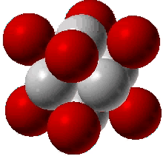
Eight atoms are occupied at eight corners of a unit cell
including six atoms are situated exactly center of it’s face.

Slide 21
3. Atoms are in contact with face diagonals, hence the nearest
neighbours of any corner atom are the face centered atoms
of the surrounding unit cells.
4. Each atom has 12 nearest neighbours hence it’s
co-ordination number is 12.
Any corner atoms has 4 such atoms in it’s own plane,
4 in a plane above it and 4 in a plane below.

Slide 22
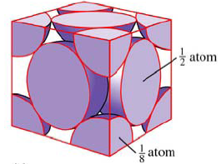
5. Total number of atoms in a unit cell are 4.
8 x 1/8 + 6 x ½ = 1 + 3 = 4 atoms
C
A
B

Slide 23
6. Atomic packing factor
From figure,
∆ ABC AC² = AB² + BC² = a² + a² = 2a² ---- (1)
But, AC = r + 2r + r = 4r --- (2)
Substituting the eq.2 in eq.1, we get,
(4r)² = 2a²
r² = 2a² /16 = a²/8
Therefore, r = a / √8 --- (3)

Slide 24
Therefore, APF = v / V
4 x 4/3 π r³
=
a³
4 x 4 x π x a³
=
(√8)³ x 3 x a³
16 x π x a³
=
(√2)16 x 3 x a³
π
=
3(√2)
=
Therefore, APF
0.74 = 74%

Slide 25
Therefore, it’s APF value is 74%. Hence, we can
say that it is a closely packed structure.
EX: Most of the metals like Copper, Lead, Aluminium,
Silver etc

Slide 26
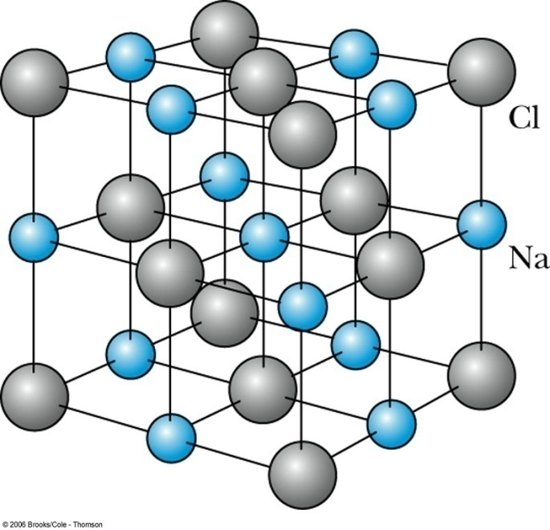
NaCl-structure
1. This structure consists of two FCC sub-lattices,
with two atoms in the base: one at (0, 0, 0), the
other one at (a/2, 0, 0).

Slide 27
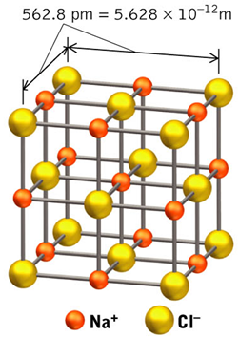

Slide 28
2. The structure follows as..
Cl
+
NaCl
Na

Slide 29
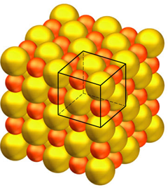
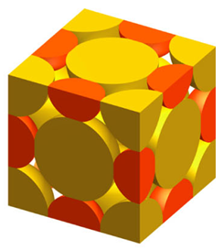

Slide 30
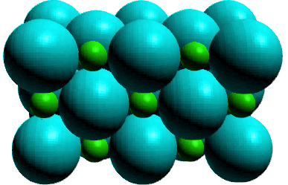
3. In 3-dimension the NaCl structure is …

Slide 31
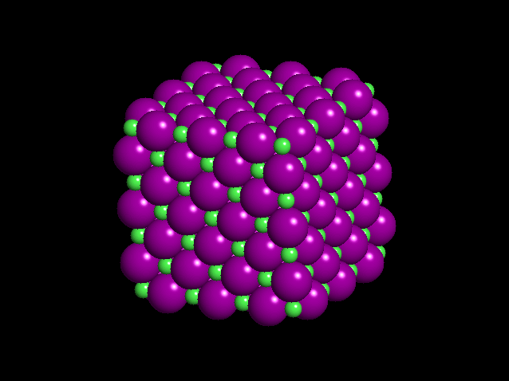

Slide 32
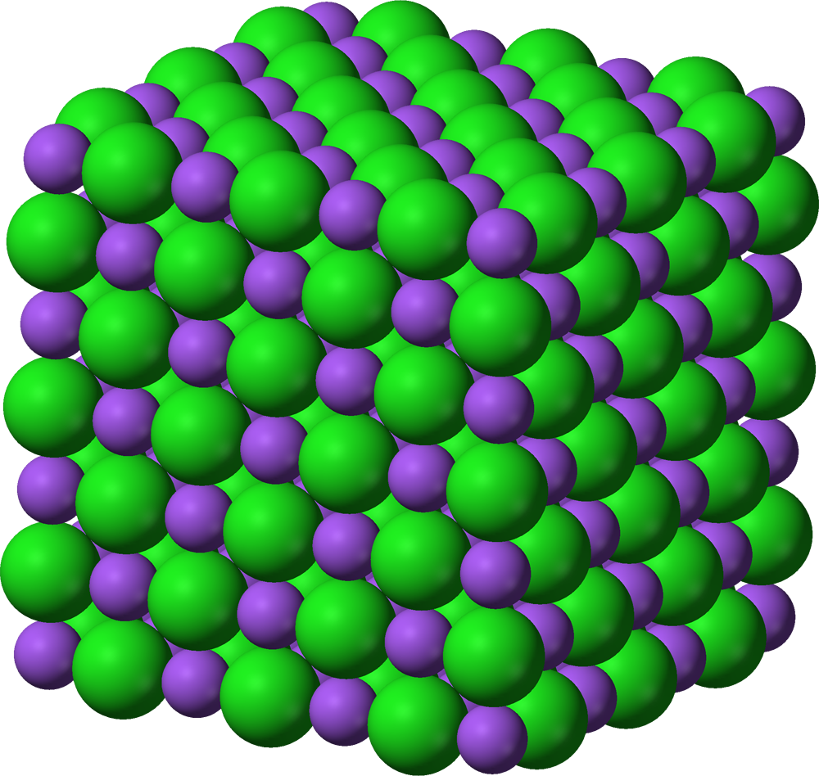

Slide 33
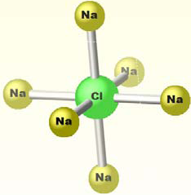
4. Its co-ordination number is 6.

Slide 34
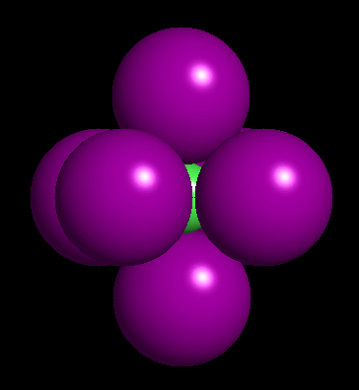
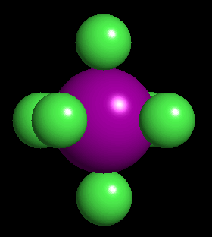
Its co-ordination number is 6.
Na
CI
Na
Na
Na
CI
CI
Na
CI
Cl

Slide 35
Each unit cell in NaCl has 4 sodium ions and
4 associated chloride ions. Thus there are 4 molecules
in a unit cell.
In NaCl crystal the distance between adjacent atoms
are given by
d = (M/2Nρ)^{1/3} cm
M ----- mass of the molecule
N ----- No. of molecules
Ρ ----- density of NaCl

Slide 36
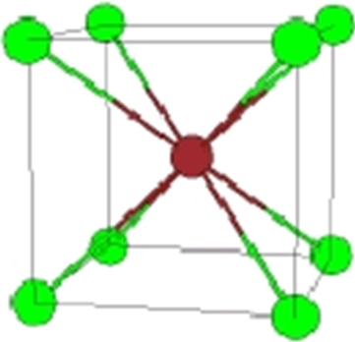
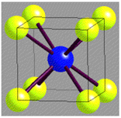
CsCl-structure
Cl
(Almost all same in size)
Cs

Slide 37
Cesium ion is the body centre of the cube and the chlorine
ion is present at each corner of the cube as shown in figure.
The lattice points of CsCl are two interpenetrating simple cubic lattices.
(i.e. One sub-lattice is at corner occupied by Cl and second is at body centre by Cs.)
It is similar to BCC structure . Hence, its co-ordination number
is 8 because each Cs ion have 8 nearest Cl ions and vice-versa.
3. Cs and Cl ions have approximately the same size.
Ex: CaBr, Cal, NH₄Cl

Slide 38

Theoretical density, ρ
_{Density = ρ =} Mass of atoms in unit cell
Total volume of unit cell
ρ =
n A V_{C} N_{A}
where
n = number of atoms/unit cell
A = atomic weight
V_{C} = Volume of unit cell = a³ for cubic
N_{A} = Avogadro’s number
= 6.023 x 10²³ atoms/mol
Ex: Cu (FCC)
A = 63.54 g/mol
R = 0.128 nm
n = 4
atoms unit cell
ρ =
g
4
63.54
^{ρ}theoretical
= 8.9 g/cm³
mol
_{a} 3
6.023 x 10²³
^{ρactual} = 8.94 g/cm³
volume
a = 2 2 R
atoms
unit cell
mol
37

Slide 39
